Slide 1
HDDM Tutorial
Alexander Fengler, Brown University

Slide 2
Outline
HDDM: Decomposing the Title
Using HDDM:
Installation
Notes on Convergence
The Main Classes (HDDM, HDDMStimCoding, HDDMRegressor)
Possible model formulations
Priors
Code Examples
Further Topis (what we ignored)

Slide 3
Outline
HDDM: Decomposing the Title
Using HDDM:
Installation
Notes on Convergence
The Main Classes (HDDM, HDDMStimCoding, HDDMRegressor)
Possible model formulations
Priors
Code Examples
Further Topis (what we ignored)

Slide 4
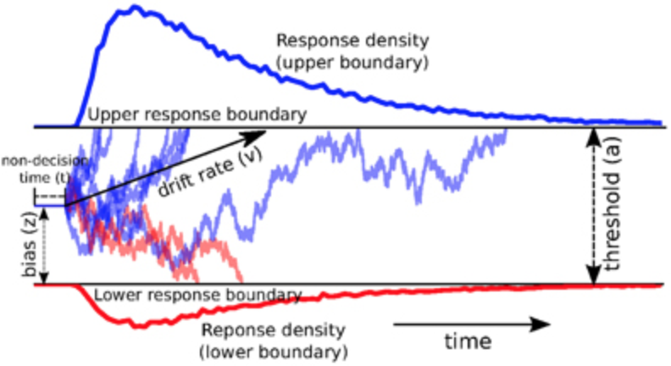
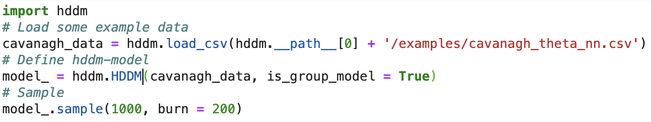
What is HDDM ?
(H)ierarchical (D)rift (D)iffusion (M)odeling….

Slide 5
(H)ierarchical (D)rift (D)iffusion (M)odeling

Slide 6
(H)ierarchical (D)rift (D)iffusion (M)odeling

Slide 7
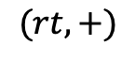
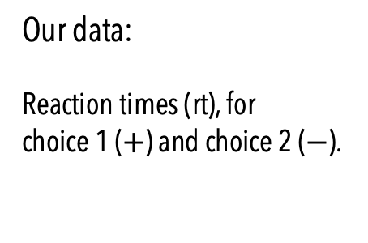
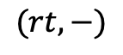
Quantities of Interest to us:
$$(rt, +)$$
Our data:
Reaction times (rt), for
choice 1 ($+$) and choice 2 ($−$).
$$(rt, −)$$

Slide 8
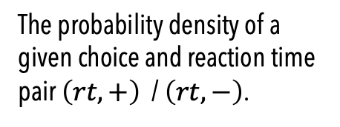
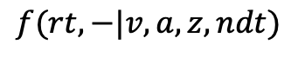
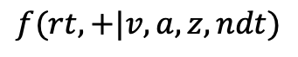
Quantities of Interest to us:
$$(rt, +)$$
$$f(rt, +|v, a, z, ndt)$$
Our data:
Reaction times (rt), for
choice 1 ($+$) and choice 2 ($−$).
The probability density of a given choice and reaction time pair $\left(rt, +\right)$ / $\left(rt, −\right)$.
$$(rt, −)$$
$$f(rt, −|v, a, z, ndt)$$

Slide 9

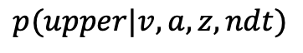

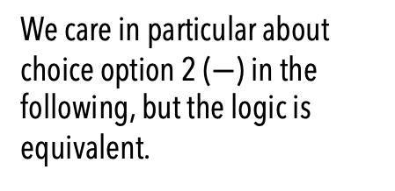
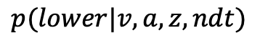
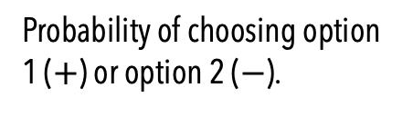
Quantities of Interest to us:
$$p(upper|v, a, z, ndt)$$
Probability of choosing option 1 ($+$) or option 2 ($−$).
We care in particular about choice option 2 ($−$) in the following, but the logic is equivalent.
$$p(lower|v, a, z, ndt)$$

Slide 10
Quantities of Interest to us:
$$p\left(upper \right| v, a ,z, ndt)=∫f\left(rt, + | v, a, z, ndt\right)$$
Probability of choosing option 1 ($+$) or option 2 ($−$).
$$p(lower|v, a, z, ndt)$$

Slide 11
Questions ?

Slide 12
What is the DDM useful for?

Slide 13
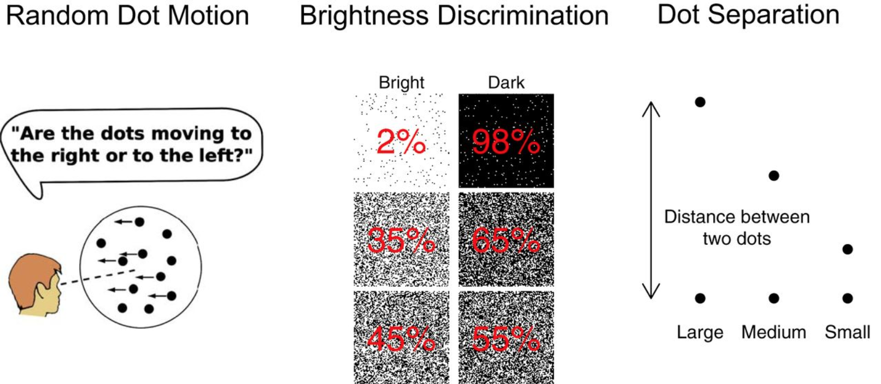
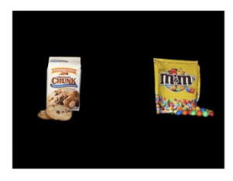
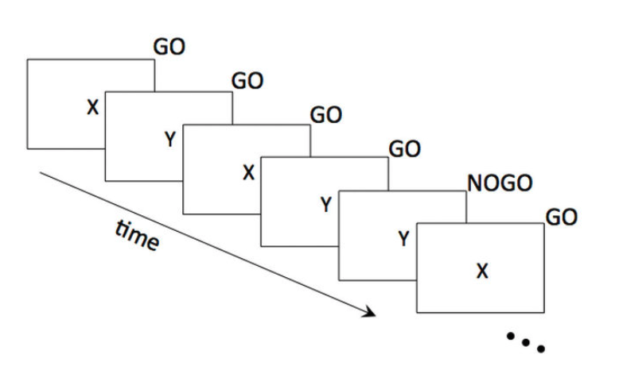
Experimental Paradigms
Random Dot Motion
Brightness Discrimination
Distance Discrimination
Preference Based Choice
Go-NoGo choices

Slide 14
Experimental Paradigms: A closer look
Random Dot Motion
Brightness Discrimination
Distance Discrimination
Preference Based Choice
Go-NoGo choices
Straightforward
Tricky: But doable

Slide 15
Experimental Paradigms: A closer look
Random Dot Motion
Brightness Discrimination
Distance Discrimination
Preference Based Choice
Straightforward

Slide 16


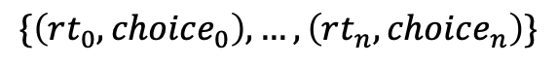
Experimental Paradigms: A closer look
Preference Based Choice
Evidence signal accumulates towards one or the other choice (here it represents a ‘relative value signal’), boundary cross emits a choice and reaction time.
Trials
$$\{\left(rt_{0}, choice_{0}\right), …, \left(rt_{n}, choice_{n}\right)\}$$

Slide 17
Experimental Paradigms: A closer look
Random Dot Motion
Brightness Discrimination
Distance Discrimination
Preference Based Choice
Go-NoGo choices
Straightforward
Tricky: But doable

Slide 18
Experimental Paradigms: A closer look
Go-NoGo choices
Tricky: But doable

Slide 19
Go-NoGo what’s different ?
Go-NoGo choices
We only observe ’Go’ choices.
‘NoGo’ choices are hidden (expressed as passing the deadline without reaction).
Tricky: But doable

Slide 20
Go-NoGo what’s different ?
‘Go’ Trials
v
Go-NoGo choices
We only observe ’Go’ choices.
‘NoGo’ choices are hidden (expressed as passing the deadline without reaction).
‘NoGo’ Trials
Tricky: But doable
- v

Slide 21
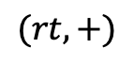
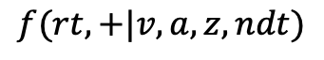
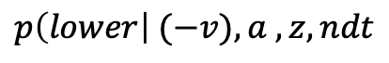
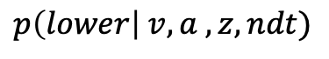
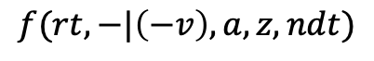
Go-NoGo what’s different ?
‘Go’ Trials
$$(rt, +)$$
v
Go-Choice
$$f(rt, +|v, a, z, ndt)$$
Go-NoGo choices
Go-Trial
$$p\left(lower\right| v, a ,z, ndt)$$
NoGo-Choice
Trials
Go-Choice
$$f(rt, −|\left(−v\right),a, z, ndt)$$
‘NoGo’ Trials
NoGo-Trial
- v
NoGo-Choice
$$p\left(lower\right| (−v), a ,z, ndt$$

Slide 22
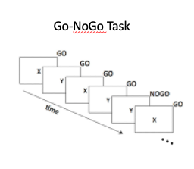
‘Go’ Trials
v
Go-NoGo Task
‘NoGo’ Trials
- v

Slide 23
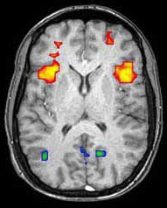
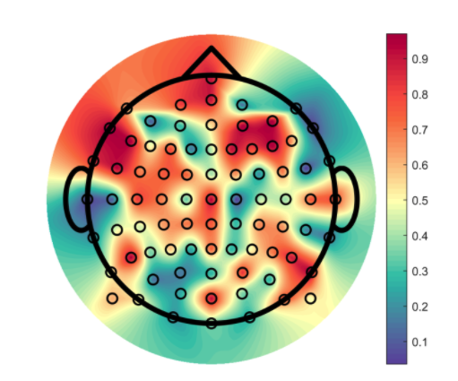
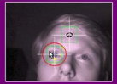
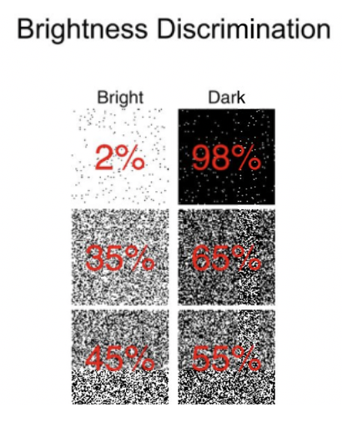

Experimental Paradigms: A broader look
Latent Process affecting trial-by-trial parameterization
Update parameters based on feedback (e.g. RL!)
Covariates
Trials
Process Evidence
Stimulus
Assumed Generative Model
Conditions
Subjects

Slide 24

(H)ierarchical (D)rift (D)iffusion (M)odeling
Bayesian (Modeling)!
Our Model
Our Data
Parameters
Posterior
$$p\left(θ | x\right)∝p\left(x | θ\right)p(θ)$$
We only care about proportionality
Likelihood
Prior

Slide 25
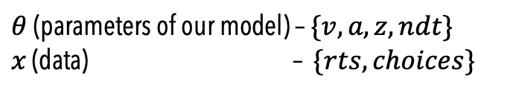
(H)ierarchical (D)rift (D)iffusion (M)odeling
$θ$(parameters of our model) – $\{v, a, z, ndt\}$
$x$ (data) – $\{rts, choices\}$
Our Model
Our Data
Parameters
Posterior
$$p\left(θ | x\right)∝p\left(x | θ\right)p(θ)$$
We only care about proportionality
Likelihood
Prior

Slide 26
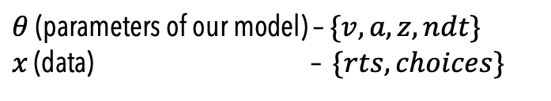
(H)ierarchical (D)rift (D)iffusion (M)odeling
$θ$(parameters of our model) – $\{v, a, z, ndt\}$
$x$ (data) – $\{rts, choices\}$
For inference, we care about this term !
Our Model
Our Data
Parameters
Posterior
$$p\left(θ | x\right)∝p\left(x | θ\right)p(θ)$$
We only care about proportionality
Likelihood
Prior

Slide 27
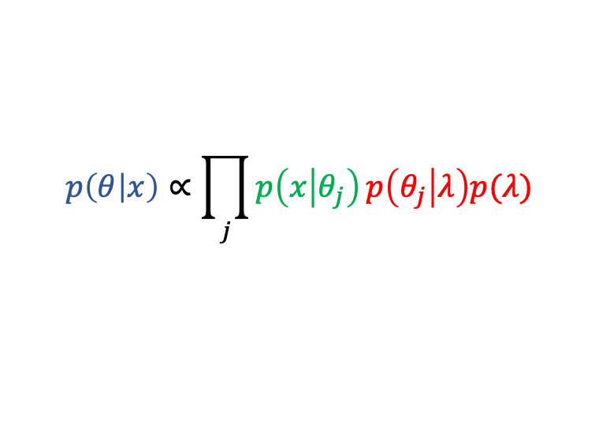
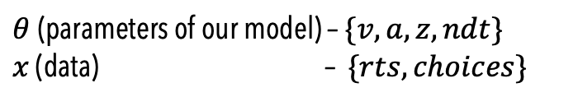
(H)ierarchical (D)rift (D)iffusion (M)odeling
$θ$(parameters of our model) – $\{v, a, z, ndt\}$
$x$ (data) – $\{rts, choices\}$
For inference, we care about this term !
Our Model
Our Data
Parameters
$$p\left(θ | x\right)∝\prod_{j}{p\left(x | θ_{j}\right)}p\left(θ_{j} | λ\right)p(λ)$$
We only care about proportionality
Posterior
Prior
Likelihood
Group Prior

Slide 28
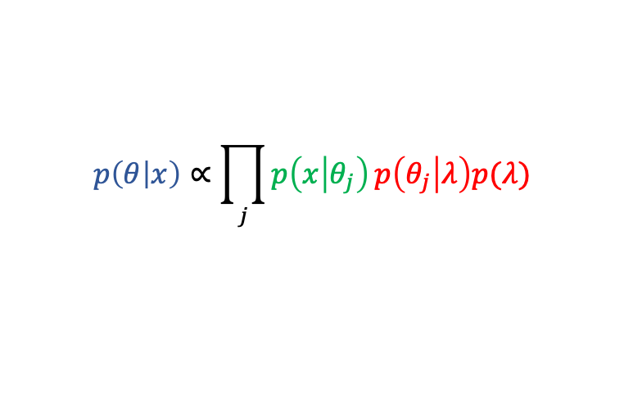
(H)ierarchical (D)rift (D)iffusion (M)odeling
Our Model
Our Data
Parameters
$$p\left(θ | x\right)∝\prod_{j}{p\left(x | θ_{j}\right)}p\left(θ_{j} | λ\right)p(λ)$$
We only care about proportionality
Posterior
Prior
Likelihood
Group Prior
HDDM provides us with samples from the posterior, for a range of experimental designs and prior assumptions on the parameters, given that our generative model is the Drift Diffusion Model.

Slide 29
Questions ?

Slide 30
Outline
HDDM: Decomposing the Title
Using HDDM:
Installation
Notes on Convergence
The Main Classes (HDDM, HDDMStimCoding, HDDMRegressor)
Possible model formulations
Priors
Code Examples
Further Topis (what we ignored)

Slide 31
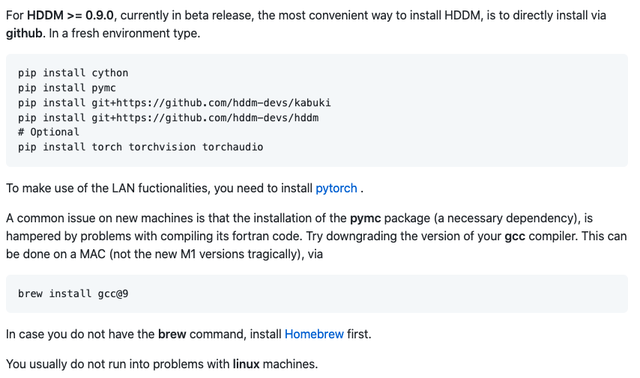
Installation !
But recommended for the extra functionality !
https://github.com/hddm-devs/hddm
This step can create problems
Especially on new Macs !
Ignore for now !

Slide 32
Turning the crank

Slide 33
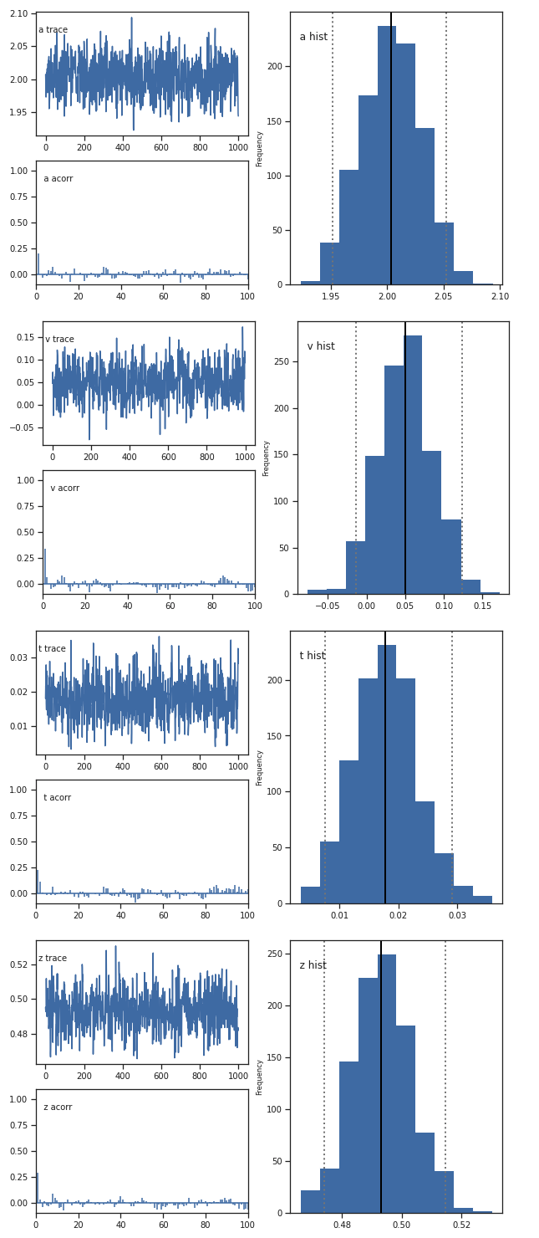
Turning the crank
We get back posterior samples (traces)

Slide 34
Turning the crank
We get back posterior samples (traces)

Slide 35
Assessing Convergence
General workflow:
Go from simpler models to more complex taking successful convergence as the stepping stone.
Run several chains (can do in parallel via e.g. multiprocessing python library)
Visually check the traces
Check the Gelman Rubin Statistic (compares traces across chains)
If Gelman Rubin ok, check posterior predictive and look into the parameter statistics of interest (hypothesis derived from project).
We will show examples later

Slide 36
Assessing Convergence
General workflow:
Go from simpler models to more complex taking successful convergence as the stepping stone.
Run several chains (can do in parallel via e.g. multiprocessing python library)
Visually check the traces
Check the Gelman Rubin Statistic (compares traces across chains)
If Gelman Rubin ok, check posterior predictive and look into the parameter statistics of interest (hypothesis derived from project goals).
What happens if chains didn’t converge?

Slide 37
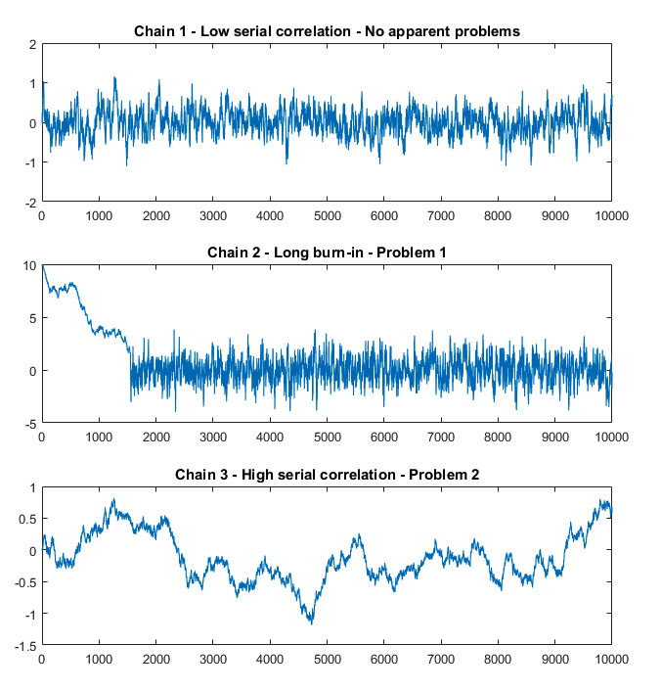
Assessing Convergence
Chain looks good?!
Tricky (but unusual) case if Gelman Rubin fails and chains look like this. Hints at multimodal posterior.
Separate chains sample around separate modes (should be apparent from the traces across chains / mean shifts).
Try a few more chains and verify that some of the modes are indeed much worse, then it’s fair to focus on the chains that sample from the ’good’ modes.
If not… hard to resolve
Check the traces:

Slide 38
Assessing Convergence
Check the traces:
Initial drift towards high density region in posterior makes up significant part of the chain.
Run longer chain!

Slide 39
Assessing Convergence
Check the traces:
Chain doesn’t mix well.
Easy solution is to run the chain for a lot longer.
Problem usually stems from either bad choice of sampler parameters or highly correlated parameters in the posterior.
We will talk about this some more later, but generally this is not trivial to resolve.

Slide 40
Assessing Convergence
Check the traces:
Other ways to resolve issues:
Try changing priors (informative – uninformative).
Take a look back at the data. Are there potentially outliers that need to be taken into account?
If yes, delete outliers and / or change the p_outlier parameter in HDDM.

Slide 41
Assessing Convergence: Other Metrics
IDEA:
Compare first half of a chain with second half.
Geweke + Gelman Rubin is quite solid evidence for convergence.
HDDM:
Geweke statistic (check for convergence within chain)
OTHER POSSIBILITIES:
Good overview paper
chrome-extension://efaidnbmnnnibpcajpcglclefindmkaj/https://arxiv.org/pdf/1909.11827.pdf
There are more recent innovations concerning the Gelman Rubin statistic
https://projecteuclid.org/journals/bayesian-analysis/advance-publication/Rank-Normalization-Folding-and-Localization--An-Improved-Rˆ-for/10.1214/20-BA1221.full
You can compute these from the traces, however currently not implemented in HDDM.
We are working towards integration of HDDM with the ARVIZ library.
This library provides support for many types of diagnostics and extra plots (but not originally designed to be compatible with HDDM).

Slide 42
Experimental Paradigms and HDDM() counterparts
Latent Process affecting trial-by-trial parameterization
Update parameters based on feedback (e.g. RL!)
Covariates
Trials
Process Evidence
Stimulus
Assumed Generative Model
Conditions
Subjects

Slide 43
Experimental Paradigms and HDDM() counterparts
Latent Process affecting trial-by-trial parameterization
Update parameters based on feedback (e.g. RL!)
Covariates
Trials
Process Evidence
All these aspects can be modeled with HDDM.
Stimulus
Assumed Generative Model
Conditions
Subjects

Slide 44
Experimental Paradigms and HDDM() counterparts
Latent Process affecting trial-by-trial parameterization
Update parameters based on feedback (e.g. RL!)
Covariates
Trials
Process Evidence
Stimulus
HDDM() class
Assumed Generative Model
Conditions
Subjects

Slide 45
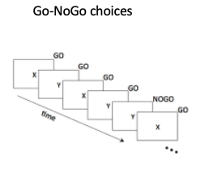
Experimental Paradigms and HDDM() counterparts
Latent Process affecting trial-by-trial parameterization
Update parameters based on feedback (e.g. RL!)
Covariates
Trials
Process Evidence
HDDMStimCoding() class
Stimulus
Assumed Generative Model
Conditions
Subjects

Slide 46
Experimental Paradigms and HDDM() counterparts
Latent Process affecting trial-by-trial parameterization
Update parameters based on feedback (e.g. RL!)
Covariates
Trials
Process Evidence
Stimulus
HDDMRegressor()
class
Assumed Generative Model
Conditions
Subjects

Slide 47
Experimental Paradigms and HDDM() counterparts
HDDMrl() class
(we won’t really talk about it)
Latent Process affecting trial-by-trial parameterization
Update parameters based on feedback (e.g. RL!)
Covariates
Trials
Process Evidence
Stimulus
Assumed Generative Model
Conditions
Subjects

Slide 48
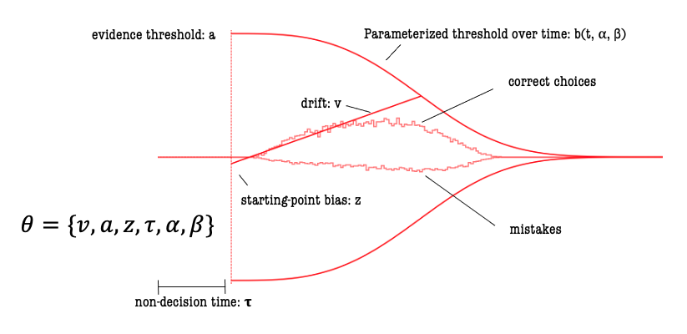
Experimental Paradigms and HDDM() counterparts
Latent Process affecting trial-by-trial parameterization
Update parameters based on feedback (e.g. RL!)
Covariates
Trials
Process Evidence
Stimulus
Assumed Generative Model
Conditions
HDDMnn() class
(we won’t really talk about it)
Subjects

Slide 49
Some Notes on the HDDMRegressor() class (1)
Generally,
HDDMRegressor()
Always use the HDDMRegressor class ?!
The HDDMRegressor() class is slower.
So if you don’t need a regression model, you will benefit from the other
Classes.
HDDM ()
HDDMStimCoding ()

Slide 50
Intermezzo: What is HDDMStimCoding?
HDDMRegressor()
HDDM()
HDDMStimCoding ()

Slide 51
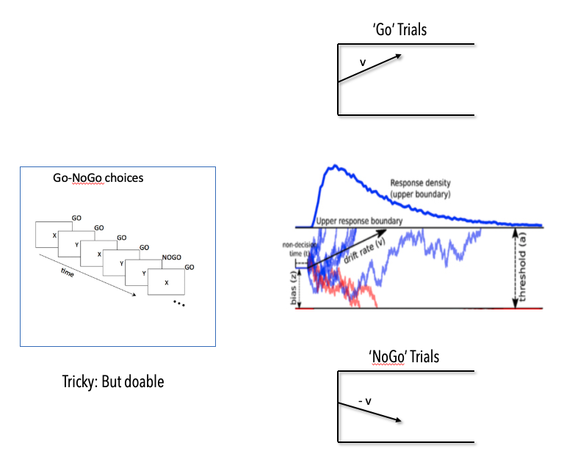
Intermezzo: What is Stim-Coding?
Remember Go-Nogo

Slide 52
Intermezzo: What is Stim-Coding?
‘Go’ Trials
v
We could model this as two conditions, but this would be wasteful.
A reasonable assumption is that there is one underlying drift, and it flips sign based on the condition (stimulus).
HDDMStimCoding() is designed to cover this case, but we can replicate the functionality via HDDMRegressor()
(We will see an example)
Go-NoGo choices
‘NoGo’ Trials
- v

Slide 53
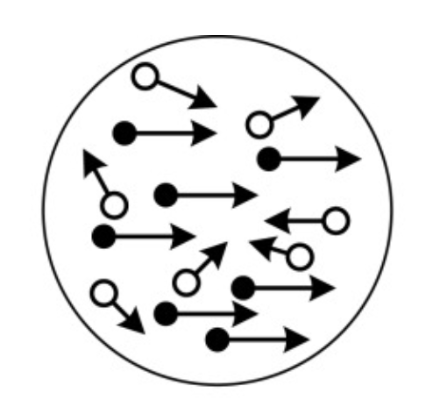
Intermezzo: What is Stim-Coding?
Condition 1
We could model this as two conditions, but this would be wasteful.
A reasonable assumption is that there is one underlying drift, and it flips sign based on the condition (stimulus).
HDDMStimCoding() is designed to cover this case, but we can replicate the functionality via HDDMRegressor()
(We will see an example)
Correct
v
Incorrect
Similar Idea
Condition 2
Incorrect
- v
Correct

Slide 54
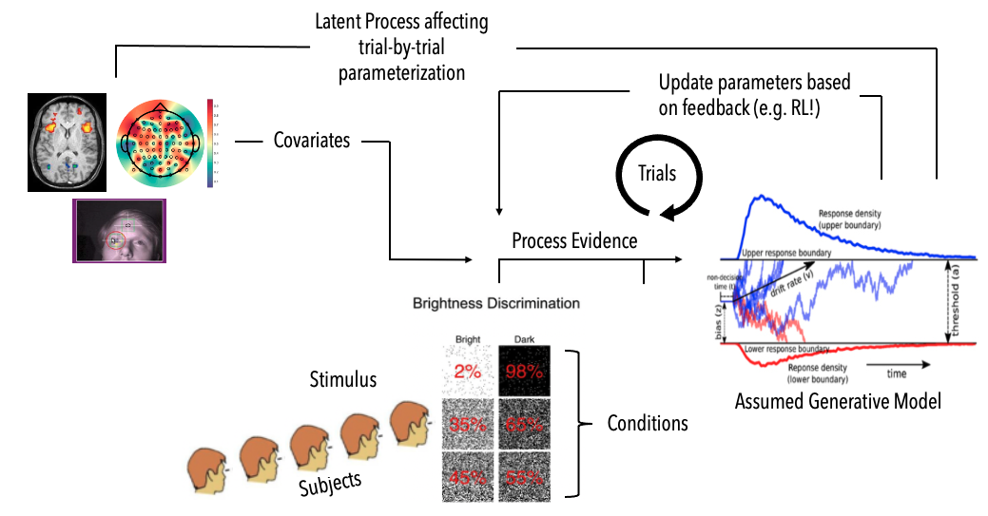
Some Notes on the HDDMRegressor() class (2)
HDDMRegressor() allows trial-wise covariates to affect the parameters of the DDM on a trial by trial basis.
This goes beyond the functionality of the depends_on argument in the base HDDM() class
(can be seen as a superset, but sometimes you may want to use HDDMRegressor() and still include depends_on).
From a user perspective patsy allows you for formulate
regression model strings with a simple syntax.
For all that is possible with patsy, I defer to it’s documentation.
We will explore some of the ways we can exploit it through HDDM
with code examples.

Slide 55
Some Notes on the HDDMRegressor() class (3)
You can in principle define a regression model for any (all) of the DDM parameters.
For a given regression model you need to define two things:
A model string
A link function

Slide 56
Some Notes on the HDDMRegressor() class (3)
You can in principle define a regression model for any (all) of the DDM parameters.
For a given regression model you need to define two things:
A model string
A link function
Patsy syntax

Slide 57
Some Notes on the HDDMRegressor() class (3)
You can in principle define a regression model for any (all) of the DDM parameters.
For a given regression model you need to define two things:
A model string
A link function
Let’s look at a couple examples !

Slide 58
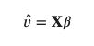
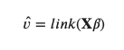
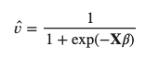
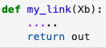
Some Notes on the HDDMRegressor() class (4)
Link Functions (we will see code examples):
The link functions allow great flexibility, however you often want to stick with the identity link in practice.
Standard Linear Regression
Logistic Link
Any function !

Slide 59
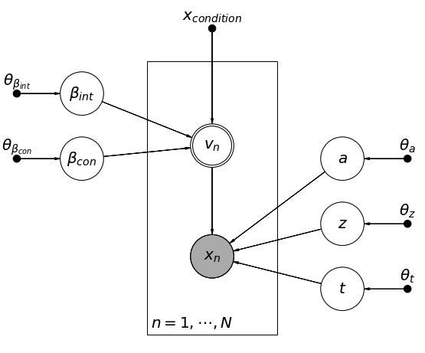
Some Notes on the HDDMRegressor() class (4)
Model Formulations: Deep Dive

Slide 60
Some Notes on the HDDMRegressor() class (5)
Model Formulations: Deep Dive
Observed Quantity (Data), assumed to stem from our model.

Slide 61
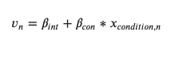
Some Notes on the HDDMRegressor() class (5)
Model Formulations: Deep Dive
Computed quantity
(deterministic transformation / our regression model)

Slide 62
Some Notes on the HDDMRegressor() class (5)
Fixed: covariates
Model Formulations: Deep Dive
Fixed: prior parameters
Fixed: prior parameters

Slide 63
Some Notes on the HDDMRegressor() class (5)
Model Formulations: Deep Dive
Latent (random) variables.
Parameters over which we want to get posteriors.
Each has their respective prior assigned.

Slide 64
Some Notes on the HDDMRegressor() class (5)
Intercept
Model Formulations: Deep Dive
For regression models with identity link functions the intercept has the same prior as the regressor.
The rest of the betas get a simple normal priors.
Covariate

Slide 65
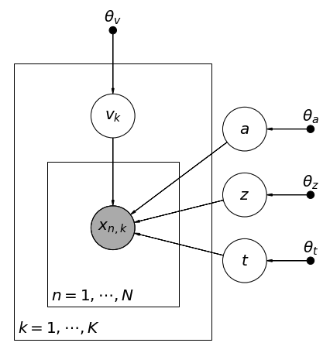
More Notes on Model Formulations: depends_on ... (single subject)
Stimulus groups

Slide 66
More Notes on Model Formulations: depends_on ... (single subject)
Trials

Slide 67
More Notes on Model Formulations: depends_on ... (single subject)
same prior for all v’s
v depends on stimulus condition

Slide 68
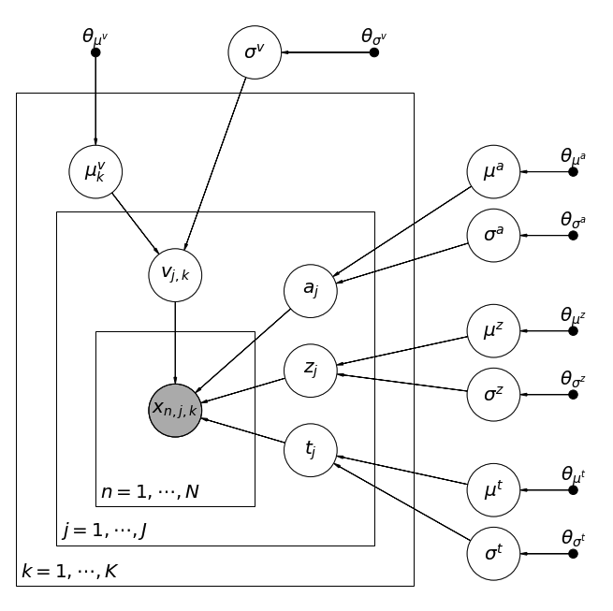
More Notes on Model Formulations: depends_on ... (hierarchical)
Parameters are now defined on a subject by subject level.

Slide 69
More Notes on Model Formulations: depends_on ... (hierarchical)
And stem from group level priors.

Slide 70
More Notes on Model Formulations: depends_on ... (hierarchical)
The group level prior standard deviation is defined globally.
The group level prior mean is defined for each group.

Slide 71
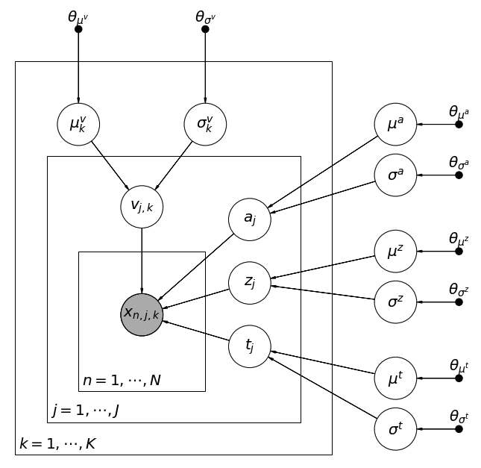
More Notes on Model Formulations: depends_on ... (hierarchical)
The group level prior standard deviation is defined group wise.
(argument: std_depends = True)
The group level prior mean is defined for each group.

Slide 72
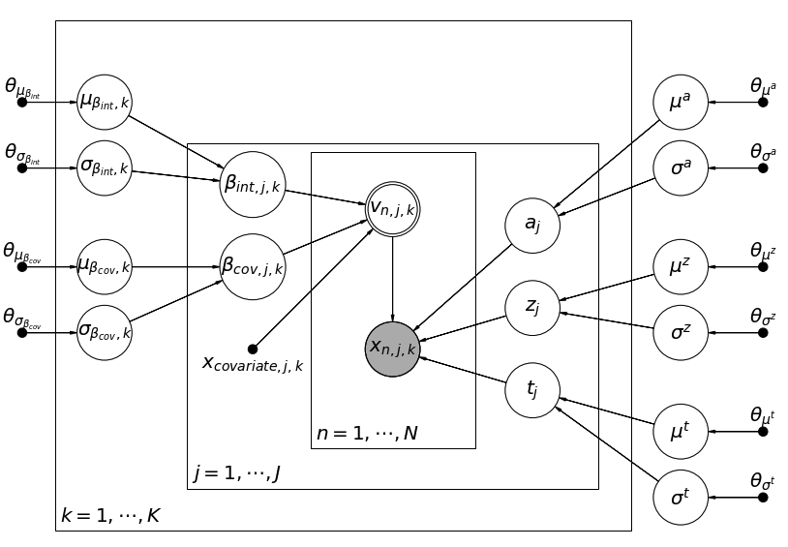
More Notes on Model Formulations: Combining depends_on with regression models
This is pretty much as complex as we can go...
std_depends = True

Slide 73
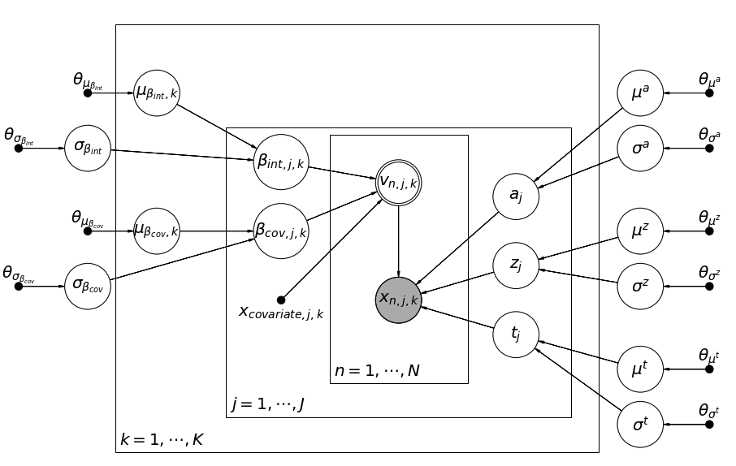
More Notes on Model Formulations: Combining depends_on with regression models
This is pretty much as complex as we can go...
std_depends = False

Slide 74


Prior Distributions
In general, we can not pick priors freely in HDDM as of now.
You can choose between informative and uninformative priors.
Uninformative priors generally assume a uniform distribution.
Informative priors are parameter specific.
Wiecki et. al. (2013)

Slide 75
Outline
HDDM: Decomposing the Title
Using HDDM:
Installation
Notes on Convergence
The Main Classes (HDDM, HDDMStimCoding, HDDMRegressor)
Possible model formulations
Priors
Code Examples
Further Topis (what we ignored)

Slide 76


Slide 77
Outline
HDDM: Decomposing the Title
Using HDDM:
Installation
Notes on Convergence
The Main Classes (HDDM, HDDMStimCoding, HDDMRegressor)
Possible model formulations
Priors
Code Examples
Further Topis (what we ignored)

Slide 78
Things we didn’t emphasize (1)
Variability parameters (sv, sz, st)
Nothing fundamentally changes, however:
Inference will be slower if you include sz / st (less penalty for including sv)
The variability parameters are hard to identify usually (need lots of data)

Slide 79
Things we didn’t emphasize (2)
Parameter recovery studies,
The simulator_h_c() can be very helpful here. (see documentation)
I personally think it is part of any serious workflow. One needs to make sure that for a given experimental design under assumptions of the likelihood model (DDM) parameter estimation is in fact possible.

Slide 80


Things we didn’t emphasize (3)
HDDMrl,

Slide 81


Things we didn’t emphasize (4)
LANs and other improvements to HDDM

Slide 82

Things we didn’t emphasize (5)
Extensive documentation
LANs and other improvements to HDDM

Slide 83

END
QUESTIONS ?

